Slide 1
Establishment of an International Council within the AAPM
Ad Hoc Committee to Establish an International Council within the AAPM
F. Fahey (Co-chair), J. Bayouth (Co-chair), C. Borrás, J. Van Dyk, C. Orton, M. Mahesh, R. Jeraj, I. Sechopoulos, M. Bazalova-Carter, C. McCollough, S. Huq, D. Brown

Slide 2
AAPM is An international Organization
Membership (2020 statistics):
18% of members live outside U.S., representing 95 different countries
Journals (2019 statistics):
Medical Physics:
66% of submitted manuscripts from 55 different countries
Journal of Applied Clinical Medical Physics:
63% of submitted manuscripts from 54 different countries
Annual meeting registrants from outside U.S. (2016-2019 average): 21%
Many activities with international organizations:
Joint TG reports with IAEA, ESTRO, EFOMP, ICRU, ICRP, IOMP

Slide 3
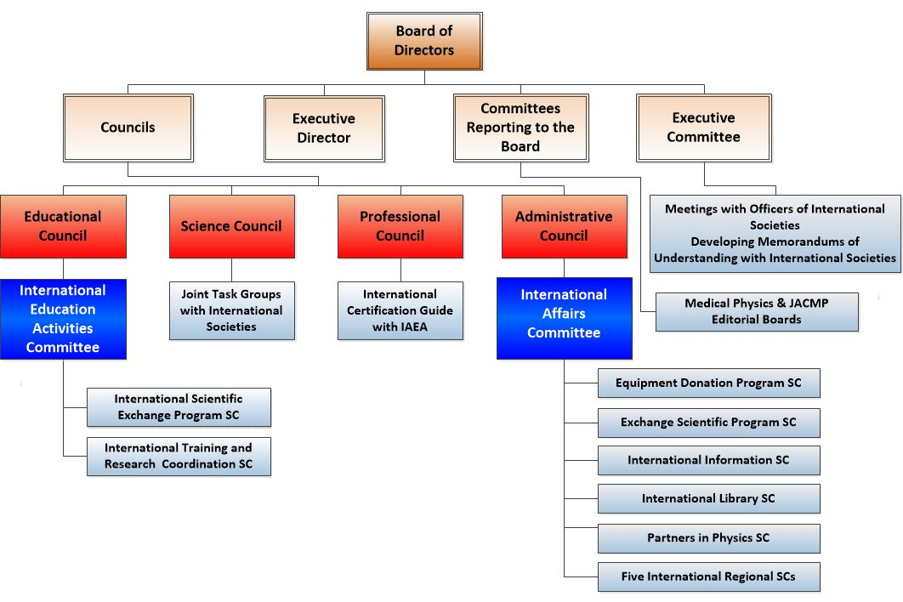
Current organizational structure
Notes:
Be clear that IEAC reports to Ed Council; IAC to Admin Council
Other activities managed by ExCom and Science Council

Slide 4
Weaknesses of the current paradigm
Duplication of effort
Lack of standardization
Lack of metrics to assess impact
Ineffective or contradictory sharing of information with partner clinics and organizations
Missed opportunities to grow the international membership base
Inability to effectively respond to changing landscapes
Suboptimal presentation of the AAPM as global leaders in the developing of quality standards
Ineffective communication of international opportunities for AAPM members
Inability for leadership to maintain clear, current knowledge of AAPM’s international efforts/partnerships

Slide 5
Guiding Principles
Essential guiding principles for creation of International Council:
These endeavors cut across all aspects of AAPM: research, education, patient care, industry, outreach, international partnerships, journals and membership.
International partnerships strengthen the AAPM and, thereby, its membership.
International collaborations strengthen the science, education, and professional practice of Medical Physics in the US.
International collaborations have the potential for contributing to improved quality and safety in healthcare, not only in the U.S. but also abroad.

Slide 6
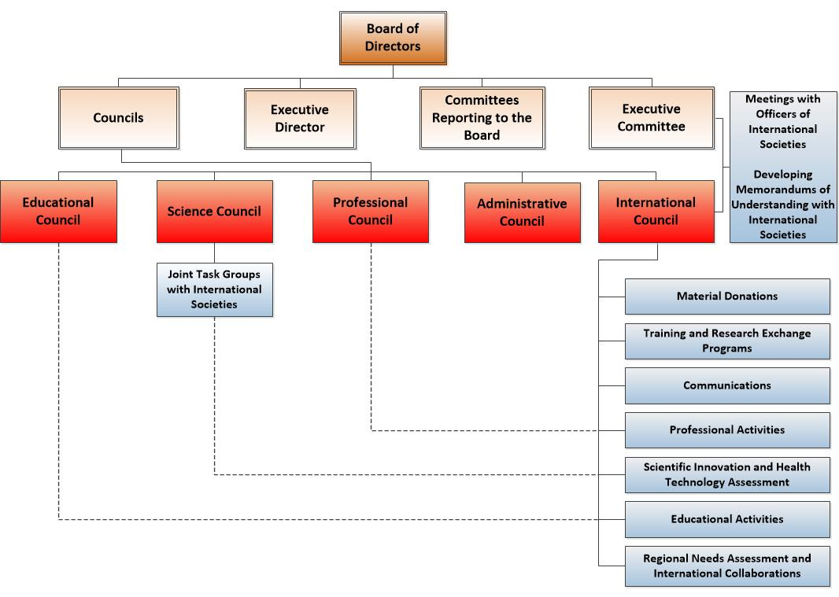
new organizational structure
Cross-council communication is built into the new structure via the make up of the International Council, which includes 1 member from each council.
Dotted lines are examples of additional communication channels via overlapping membership.

Slide 7
Strengths of the new paradigm
Single point of contact for all international engagements, both within and beyond the AAPM
Ability to set and accomplish goals, and address challenges, in an organized and coordinated fashion through centralized management and communication
Ability to develop consistent metrics to clearly demonstrate measurable value in the international arena
Establish formal mechanisms for oversight and accountability

Slide 8
Required ADDITIONAL AAPM resources (POTENTIALLY OFFSET BY FINANCIAL BENEFITS)
Staff liaison (0.3 FTE) ~ $25,000
Other estimated expenses ~$45,000
Yearly retreat
Equipment rental
Catering
Meeting registration for council chair
Total annual expense: ~$70,000 (0.6% of AAPM annual budget)
These administrative costs are in addition to board-approved annual budgets for international activities.

Slide 9
Anticipated financial benefits
Reduced expenses for current activities due to coordinated prioritization, improved efficiency and reduction of overlap
Increased international membership dues income
Increased international library subscriptions for Medical Physics
Increased international journal and website advertising
Increased income due to greater participation of international exhibitors at our conferences

Slide 10
By establishing an International Council, the AAPM will realize its mission of advancing medicine through excellence in the science, education and professional practice of Medical Physics on a DOMESTIC and global scale
For additional information, visit the Establish an International Council webpage

